Slide 1
White’s Adjusted Standard Errors
ECON 5350
Caleb Hill
Faria Manal Rahman
Taras Safonov

Slide 2
White’s Adjusted Standard Errors
Linear Regression Model:
Six classical assumptions of OLS estimation: (i) linearity, (ii) full rank, (iii) mean-zero errors, (iv) spherical disturbances (homoscedasticity and uncorrelated error terms), (v) non-stochastic regressors, and (vi) normality.
Violation of the fourth assumption: heteroscedastic error terms (𝜖).

Slide 3
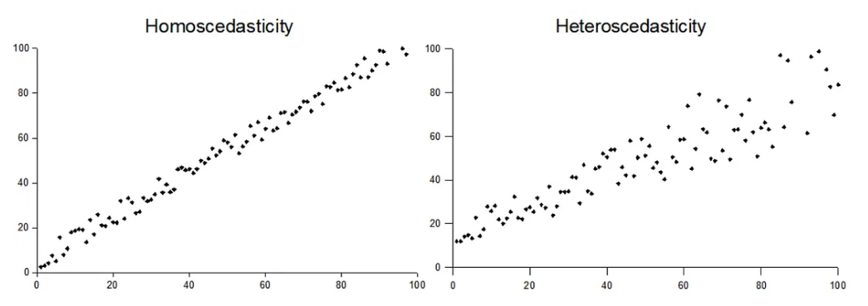
White’s Adjusted Standard Errors
Homoscedasticity: error terms have constant variances across observations.
Heteroscedasticity: error terms have different variances across observations.

Slide 4
White’s Adjusted Standard Errors
When heteroscedasticity exists, the OLS estimator (b) remains unbiased and consistent but is no longer efficient.
The variance of b is biased.
Solution: estimating the variance of b or var(b) using White’s Standard Errors or Heteroscedasticity-Consistent Standard Errors or Robust Standard Errors.
Contribution: Friedhelm Eicker, Peter J. Huber, and Halbert White.
This is a consistent estimator for var(b): as n grows large, the estimate converges to the true standard error.
No coefficients are altered.

Slide 5
White’s Adjusted Standard Errors
White’s heteroscedasticity-consistent covariance matrix estimators
Following Greene (2018), we know that the generalized linear regression model is
When Ω = I → OLS. But what if Ω ≠ I? → Heteroscedasticity (σ_{i}² on the diagonal of σ²Ω, zeros on the sides).
Then the least squares estimator is
The variance-covariance matrix of b is
If is unknown, can we still obtain consistent estimates of the variances and
covariances of OLS estimators despite heteroscedasticity? YES.

Slide 6
White’s Adjusted Standard Errors
White’s heteroscedasticity-consistent covariance matrix estimators
White (1980), showed that
The end asymptotic result being
so that σ_{i}² on the diagonal of σ²Ω, being unobservable directly, can be estimated by e_{i}², the squared residual for each i, from the original OLS regression.
This result allows us to make inferences based on the OLS estimator without having to specify the actual type of heteroscedasticity (e.g. when we do not know the precise nature
of heteroscedasticity).

Slide 7
White’s Adjusted Standard Errors
Notes on White’s standard errors
Allows to make inferences based on the OLS estimator without having to specify the actual type of heteroscedasticity.
White’s standard errors are usually larger than OLS standard errors → estimated t-values are smaller than those obtained by OLS.
Also, White’s standard errors may not be as efficient (have wider variance) than those obtained by transforming data to describe particular types of heteroscedasticity.
Is a large-sample procedure – inference about true parameters is valid asymptotically. Therefore, may not be as useful for small samples, but a number of improvements are available (see, for example, Davidson & MacKinnon (1993).

Slide 8
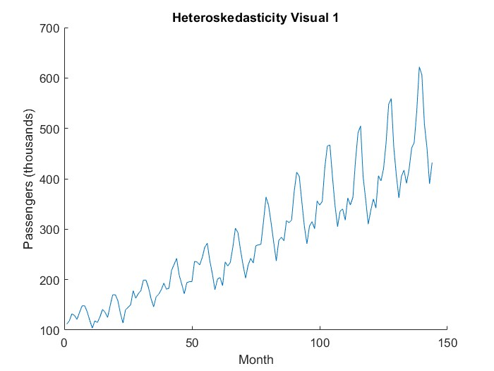
Heteroskedasticity Evidence Plot 1

Slide 9
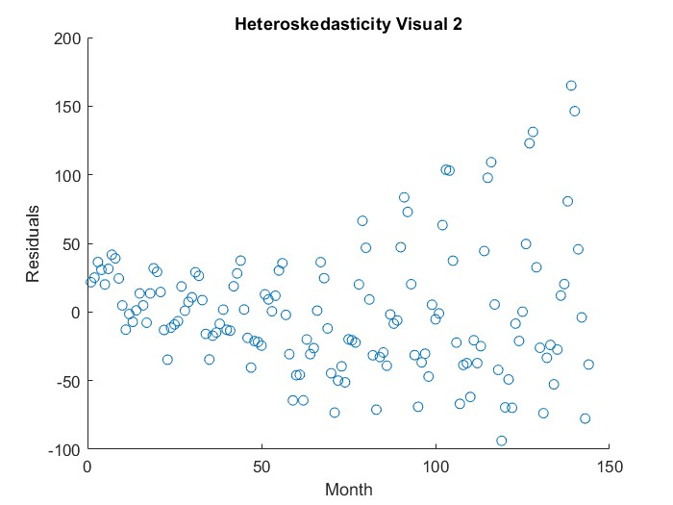
Heteroskedasticity Evidence Plot 2

Slide 10
White Test for Heteroskedasticity Output

Slide 11
OLS Output

Slide 12
OLS with White’s Standard Errors Output

Slide 13
Comparing Outputs
OLS
OLS with White’s Standard Errors

Slide 14
Comparing Outputs (Should Be Identical)
OLS with White’s Standard Errors
OLS with HAC function

Slide 15
White’s Adjusted Standard Errors
References
Davidson & MacKinnon (1993). Davidson, R., and J. MacKinnon. Estimation and Inference in Econometrics. Oxford University Press, 1993.
Greene (2018). W.H. Greene. Econometric Analysis, 8th ed. Pearson, 2018, pp. 298-301.
Gujarati & Porter (2009). D.N. Gujarati, D.C., Porter. Basic Econometrics, 5th ed. McGraw-Hill, 2009, chapter 11.
White (1980). H. White, “A Heteroscedasticity Consistent Covariance Matrix Estimator and a Direct Test of Heteroscedasticity,” Econometrica, vol. 48, 1980, pp. 817-818.

Slide 16
White’s Adjusted Standard Errors
Appendix A. White’s heteroscedasticity-consistent covariance matrix estimators
For a two-variable regression model
Therefore, in the case of heteroscedasticity
but, since σ_{i}² is unobservable, it can be estimated by e_{i}², the squared residual for each i, from the original OLS regression, such that
White showed that (3) is a consistent estimator of (2): with indefinitely increasing sample size, (3) converges into (2).

Slide 17
White’s Adjusted Standard Errors
Appendix B. Generalization to k-variable Regression Model
For a multiple linear regression model
The variance of any partial regression coefficient b_{j} is estimated as follows:
where e_{i}² are the residuals obtained from the original regression (4), and w_{ji}² are the residuals obtained from the auxiliary regression by regressing x_{j} on the remaining independent variables in (4). Equation (5) is estimated for each independent variable x.
In either case, the obtained estimates (3) and (5) can be used for inference based on
the original OLS regression results from (1) and (4), respectively.

