Slide 1
Missing Data
Katie Tenney & Connor Lubsen
What it is and how to deal with it

Slide 2
Outline
Missing data is a prevalent issue most common in survey methodology, where individuals fail to answer questions for one reason or another, but it shows up in other data as well. There are three main steps in dealing with missing data:
Identify potential reasons/patterns for missing data (WHY)
Understand the distribution of missing data (WHAT)
Decide on the best method of analysis (HOW)
Notes:
Specific Human Capital is the firm/industry specific skills that makes the worker better at their job. This often requires a sort of technical training.
Work Quality is the overall quality of work that is produced by a given worker. This notion allows us to think of the case where a worker has very high SHC but not good work quality.

Slide 3
Step 1: Identify reason for missing data
Having an idea why data are missing can give us a better idea of how to fix the problem.
Potential reasons for missing data:
Respondent refusal/Non-response
Either passive (benign) or active (problem)
Random data collection issues
e.g., lack of available data cross-section
Attrition due to social/natural processes
e.g., aging out of a school survey
Intentional missing as part of data collection process

Slide 4
Step 2: Evaluate the type of "missingness"
Certain analysis methods assume a certain probability distribution. There are three main categories to identify:
Missing Completely at Random (MCAR)
Missing value (y) neither depends on x nor y
Missing at Random (MAR)
Missing value (y) depends on x, but not y
Missing not at Random (NMAR)
The probability of a missing value depends on the variable that is missing

Slide 5
Missing Completely at Random (MCAR)
Data is missing completely at random if the missing value (y) neither depends on x nor y; unrelated to the values, or potential values, for any of the variables in or outside of the model.
i.e. if a respondent doesn't show up for an in-person survey because they were in a car crash, or just forgot to answer the question.
Can be determined using a t-test
If data are MCAR, then throwing out observations with missing data will not bias your estimated parameters.
However, this leaves you with fewer observations and reduces your statistical power (because lower n) and doesn't use all information.

Slide 6
Missing at Random (MAR)
Also known as the "ignorability assumption" is where we assume that the missing value (y) depends on x, but not y.
i.e. older people are less likely to report income on a survey, but that's because they're old, not necessarily because they have a large amount of income. Thus, the "missingness" is related to the variable age, not income itself.
It is acceptable to drop the missing observations here if the regression controls for all the variables that affect the probability of missingness, but there are other methods that may retain more information.

Slide 7
Missing Not at Random (MNAR)
Data can be MNAR (not ignorable (NI)) in two different ways:
Missingness that depends on unobserved predictors.
i.e. if it depends on information that has not been recorded and this information also predicts the missing values.
E.g.: If college educated people are less likely to report their incomes, and having a college degree is predictive of earnings, and there is also some nonresponse (missing values) to the education question. This would mean that earnings are NMAR (Gelman 2007).
Missingness that depends on the missing value itself
Example: Respondents with high income less likely to report income.

Slide 8
Step 3: Deal with missing data
Goal: Use the best analysis strategy to yield the least biased estimates.
Deletion Methods
Listwise deletion, pairwise deletion
Simple Imputation Methods
Mean substitution, dummy variable method, single regression
Model-Based Methods
Maximum Likelihood, multiple imputation

Slide 9
List-wise Deletion (Complete Case Analysis)
Simply delete the entire row (entire observation) from the dataset and ignore the problem.
Pros:
Easy
Is asymptotically unbiased if data are MCAR
Allows for comparability across analyses
Cons:
Reduces statistical power (lower n)
Doesn't use all the information
Will cause slope estimates to be biased if MAR or MNAR

Slide 10
Overview of Simple Imputation Methods
Pros:
Keep the full sample size
Can be advantageous for bias and precision
Cons:
The standard errors of estimates tend to be too low
We're essentially "playing God" by assuming we know the true values with certainty

Slide 11
Imputation Method #1: Replace with Average
Process: Replace each missing value with the mean of the observed values for that variable.
Pros:
Easiest imputation method
Uses all the information available
Doesn't bias if MCAR
Cons:
False impression of N
Causes standard deviation to be underestimated
Distorts relationships between variables by "pulling" estimates of the correlation toward zero (Gelman, 2007).

Slide 12
Imputation Method #2: Dummy Variable Approach
Process:
Create a dummy variable where the value is 0 if not missing and 1 if missing
Fill in the missing values of the variable of interest with a constant value like one or the mean.
Cons:
Assumes the observations are missing at random, which is not always the case.
Yields biased coefficient estimates for the other variables in the model because it forces the slope to be the same across both missing-data groups.
Pros:
Uses all available information for estimations
Able to get better estimate of slope

Slide 13
Imputation Method #3: Regression Imputation
Process:
Calculate the regression model using the observed variables
Impute the predicted values into the missing values
Calculate a second regression model including the imputed missing values
Compare regression results
Pros:
Uses information from observed data
Accounts for MAR data
Cons:
Overestimates model fit and correlation estimates because regression error term is not carried forward
Weakens variance

Slide 14
Brief Description of Multiple imputation
Basic steps:
Make a model that predict every missing data item (linear or logistic regression, non-linear models, etc.)
Use the above models to create a “complete” dataset.
Each time a “complete” dataset is created, do an analysis of it, keeping the mean and SE of each parameter of interest.
Repeat this between 2 and tens of thousands of times
To form final inferences, for each repetition, average across means, and sum the within and between variances for each parameter (UCL, 2015)

Slide 15
Code Application
The Model:
Salary = b1 + b2•Exper
 | No Correction | List Wise Deletion | Zero Order Method | Dummy Variable Method
Intercept | NaN | 6.1682 | 6.5249 | 6.7877
Beta One (Exper) | NaN | 0.1162 | 0.0930 | 0.0931
Beta Two (Dummy) | - | - | - | 1.5533

Slide 16
Questions?

Slide 17
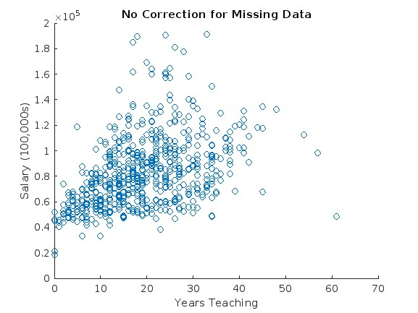
Appendix

Slide 18
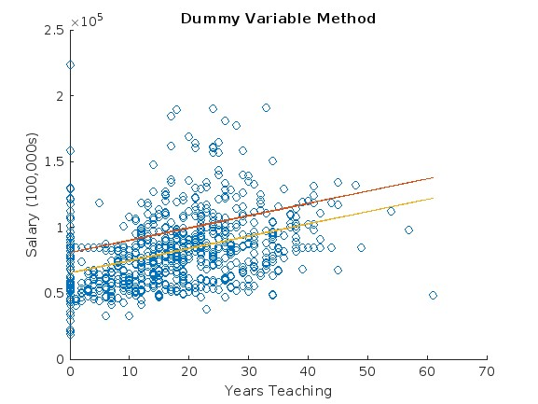
Appendix

Slide 19
Sampling Distribution for Beta One:
*True Beta value of 3

Slide 20
Citations
Gelman, A. and Hill, J. (2007) Ch 25: Missing-data imputation in Data Analysis Using Regression and Multilevel/Hierarchical Models. Cambridge University Press, New York.
https://www.publichealth.columbia.edu/research/population-health-methods/missing-data-and-multiple-imputation
University College London. (2015). Missing data analysis. https://www.ucl.ac.uk/~rmjbale/Stat/13.pdf
Humphries, M. (date unknown). Missing Data & How to Deal: An overview of missing data. Population Research Center. https://minio.la.utexas.edu/webeditor-files/prc/pdf/missing-data.pdf

